Slide 1
1.1 Basics of OS
Embedded Operating Systems
1 Introduction to Operating Systems
Shripad V Deshpande

Slide 2
What is an Operating System (OS)?
Intermediary agent between the user and the computer hardware. Hides details about the hardware from the user.
Service Provider - primarily provides services for running applications on a computer system
acts as a Resource Manager of a system.
It manages the processor, memory, and I/O devices like mouse, modem, keyboard, etc., and also a set of unlimited peripherals that we plug in and unplug from it.

Slide 3
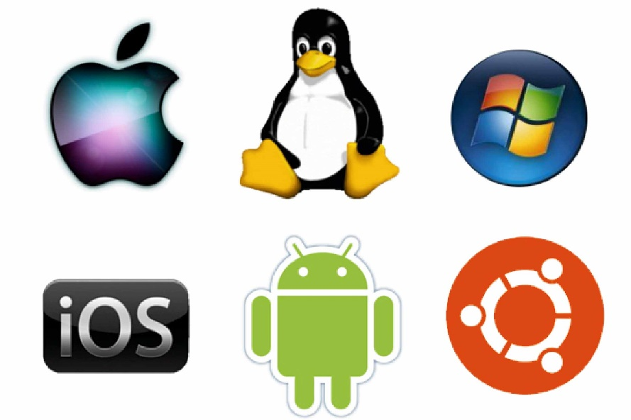
What is an Operating System (OS)?
controlling and monitoring agent to check the execution of all other programs that reside in the computer - application programs and other system software
acts as an interface between the software and different parts of the computer or the computer hardware.
Examples :

Slide 4
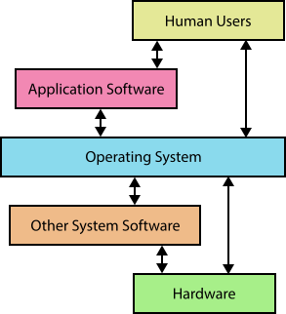
Operating System Goals
Execute user programs and make solving user problems easier
Make the computer system convenient and easy to use
Use the computer hardware resources in an efficient manner
Treat CPU, Memory, I/O devices and other peripherals as resources and make their usage efficient and fair.

Slide 5
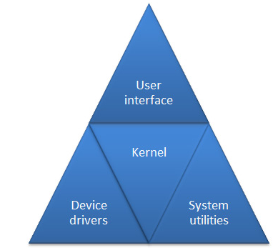
Functions Performed by an OS
Processor management
Memory management
I/O management
File management
Protection & security
OS MODEL

Slide 6
Processor Management
Processor is the most important resource responsible for doing computation and data processing. All the tasks to be completed are allocated to the processor.
Considering single processor system, only one task can be serviced at a time. So when more no. of tasks are present and all need the processor, which one will get the processor service ?
The OS needs to manage the tasks in a system efficiently such that the processor is busy in running the tasks that need the processor service.
Different task in the system execute in parallel and need to communicate with each other. The OS must maintain synchronization between them.

Slide 7
Memory Management
For execution of any program, the instructions in the program and the data needed by them must exist in memory always.
The Memory management job of the OS involves -
Determining what is in memory and when
Optimizing CPU utilization and computer response to users
Keeping track of which parts of memory are currently being used and by which program
Deciding which program (or parts thereof) and data to move into and out of memory (onto secondary storage like hard disk
Allocating and de-allocating memory to the programs as needed

Slide 8
I/O Management
There are number of I/O devices in the system and all work on different principle and protocols.
The OS manages all the I/O devices by having a device driver for each device.
Device driver:
Set of routines written for each specific device,
Takes care of the hardware setup and protocols associated with that device.
Gives a clean and well defined interface for the user to interact with the device.

Slide 9
File management
The data is stored sequentially in a file. The files are created, modified, saved, opened, closed, or deleted in directories or folders.
When user wants to open a file in a particular folder, the OS must locate it and get to the point where required data is stored in the file. And to get this done effectively the file storage has to be well structured..
The file management part of OS has to control the access to the data in the files, certain files are password protected, some are read only, some are hidden. Some program have rights of access some do not have.
To take care of this, the file manager in OS must attach a set of attributes to each file to control the access.

Slide 10
Protection & security
Protection – controlling access of processes or users to resources
Security – defense of the system against internal and external attacks
Computers may be stand-alone or networked. In any case, Multiple users/programs use them. The data and code may be shared. OS must provide protection of data in such a scenario.
Security is capability of the system to keep itself safe from external attacks e.g. from viruses, malicious software etc. It is OS’s responsibility to provide this capability.

Slide 11
Operating System Kernel
Kernel is the Central module of the OS, that loads first, and remains always in main memory.
Because it stays in memory, it must be as small as possible while still providing all the services required by other parts of the OS and applications.
Usually loaded in the protected area of memory to prevent it from being overwritten by other programs or other parts of the OS.
Typically, it is responsible for memory management, process and task management, and disk management.
Every operating system has a kernel. The Linux kernel is used by - Ubuntu, FreeBSD, Android and others

Slide 12
KERNEL SERVICES
Interrupt handling
Task creation and Scheduling
Inter process communication
Support of I/O devices
Memory allocation and de allocation
File system management
Network management

Slide 13
Types of OS
Batch Operating System
Does not interact with the computer directly. operator takes similar jobs having the same requirements and groups them into batches.
Time-Sharing Operating Systems
Tasks get an equal quantum of time for execution
Distributed Operating System
Various autonomous interconnected computers communicate with each other using a shared communication network
Real Time OS

Slide 14
A Typical OS Kernel
Applications
System Libraries (libc)
System Call Interface
I/O Related
Process Related
Modules
File Systems
Scheduler
Networking
Memory Management
Device Drivers
IPC
Architecture-Dependent Code
Hardware

Slide 15
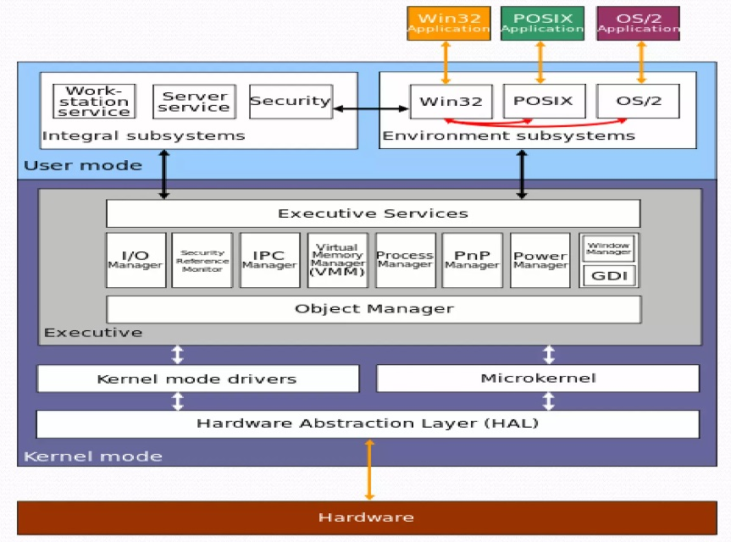
Overview of Windows OS Architecture

Slide 16
Comparison of Windows and Linux
Similarities:
concept of Kernel Mode and User Mode processes.
driver modules and hardware abstraction layers.
process managers and virtual memory managers
methods for user mode processes to call into the system kernel (Executive Services in Windows or the Kernel Interface in Linux on the diagrams).
Differences:
Linux has no registry while it is an integral part of the Windows OS.
File systems are vastly different with no concept of a “drive letter” in Linux as there is in Windows. Linux instead has a root (“/”) from which all devices mount to and this essentially creates the file hierarchy.
The GUI is completely baked into Windows and for the most part cannot be changed. In Linux you are free to use various GUI managers.
Linux has package manager utilities and Windows does not.
Windows uses the PE (Portable Executable) file format for executing files with the extension “.EXE”. Linux doesn’t really have a standard file extension to designate an executable so long as it conforms to ELF (Executable Linkable Format) it can be executed.

